Slide 1
Section R.5
Factoring Polynomials
Copyright © 2012 Pearson Education, Inc. Publishing as Prentice Hall.

Slide 2

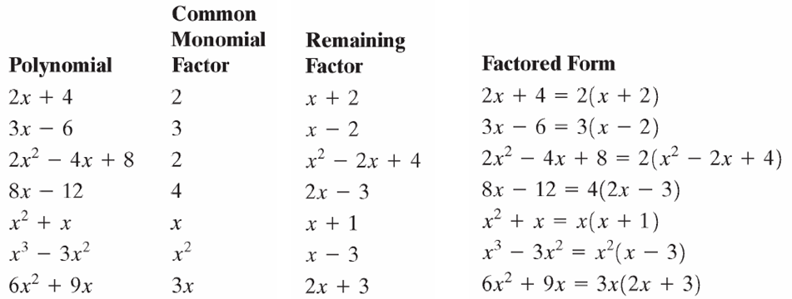
Copyright © 2012 Pearson Education, Inc. Publishing as Prentice Hall.

Slide 3

Copyright © 2012 Pearson Education, Inc. Publishing as Prentice Hall.

Slide 4
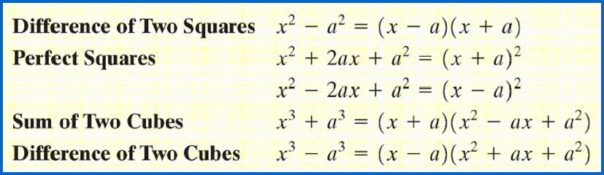

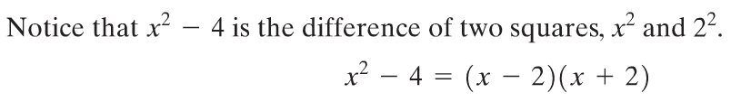
Copyright © 2012 Pearson Education, Inc. Publishing as Prentice Hall.

Slide 5

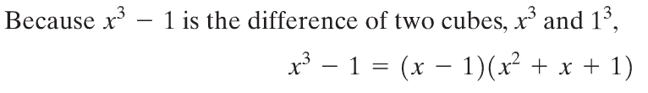
Copyright © 2012 Pearson Education, Inc. Publishing as Prentice Hall.

Slide 6

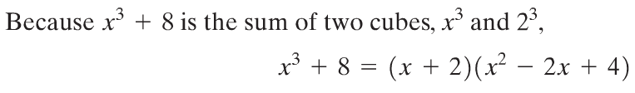
Copyright © 2012 Pearson Education, Inc. Publishing as Prentice Hall.

Slide 7

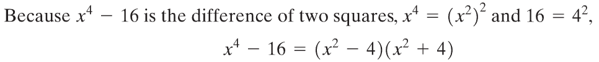
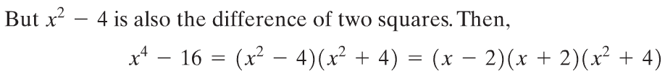
Copyright © 2012 Pearson Education, Inc. Publishing as Prentice Hall.

Slide 8

Copyright © 2012 Pearson Education, Inc. Publishing as Prentice Hall.

Slide 9

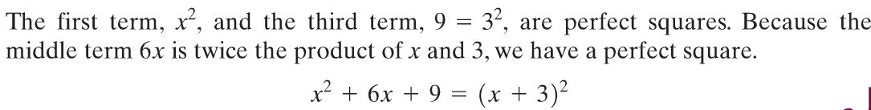

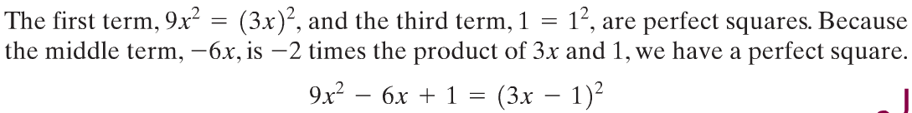

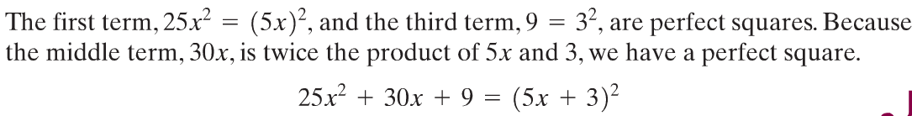
Copyright © 2012 Pearson Education, Inc. Publishing as Prentice Hall.

Slide 10
Copyright © 2012 Pearson Education, Inc. Publishing as Prentice Hall.

Slide 11
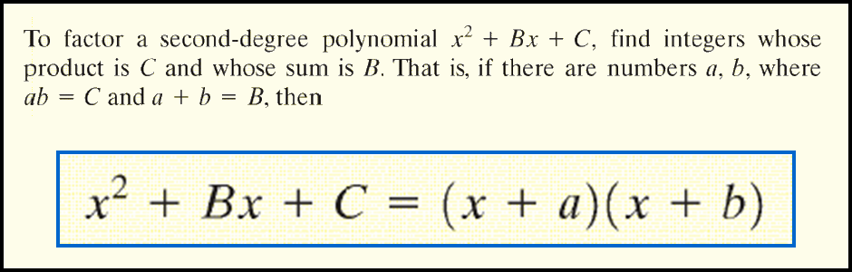
Copyright © 2012 Pearson Education, Inc. Publishing as Prentice Hall.

Slide 12

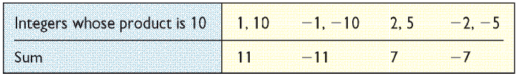
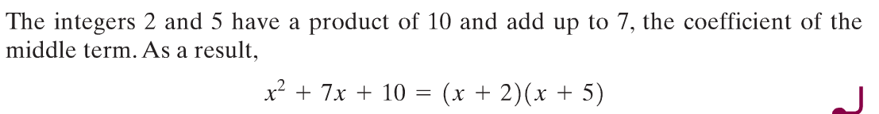
Copyright © 2012 Pearson Education, Inc. Publishing as Prentice Hall.

Slide 13
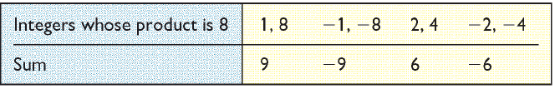
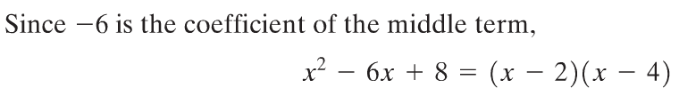
Copyright © 2012 Pearson Education, Inc. Publishing as Prentice Hall.

Slide 14
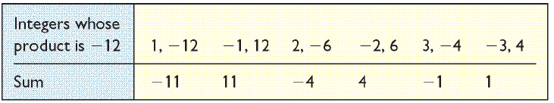
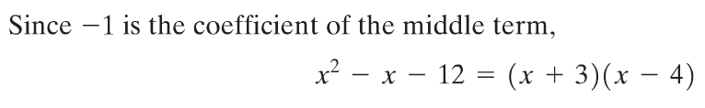
Copyright © 2012 Pearson Education, Inc. Publishing as Prentice Hall.

Slide 15
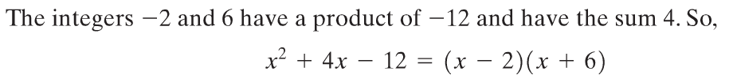
Copyright © 2012 Pearson Education, Inc. Publishing as Prentice Hall.

Slide 16

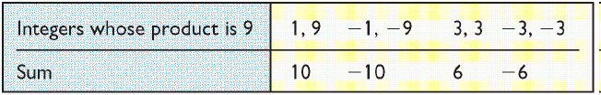

Copyright © 2012 Pearson Education, Inc. Publishing as Prentice Hall.

Slide 17

Copyright © 2012 Pearson Education, Inc. Publishing as Prentice Hall.

Slide 18

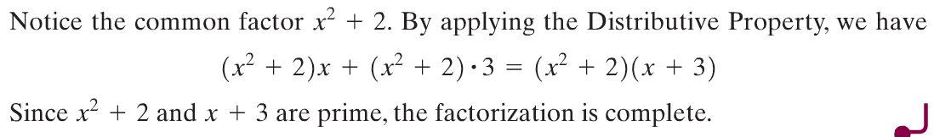


Copyright © 2012 Pearson Education, Inc. Publishing as Prentice Hall.

Slide 19



Copyright © 2012 Pearson Education, Inc. Publishing as Prentice Hall.

Slide 20
Copyright © 2012 Pearson Education, Inc. Publishing as Prentice Hall.

Slide 21
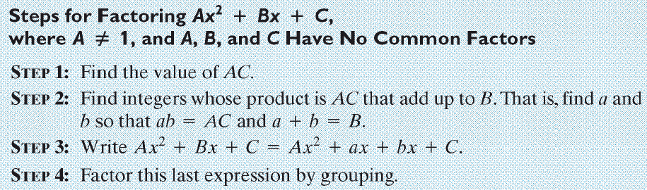
Copyright © 2012 Pearson Education, Inc. Publishing as Prentice Hall.

Slide 22



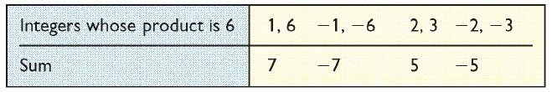
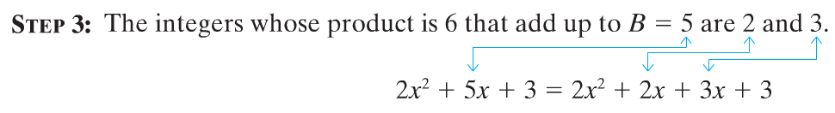
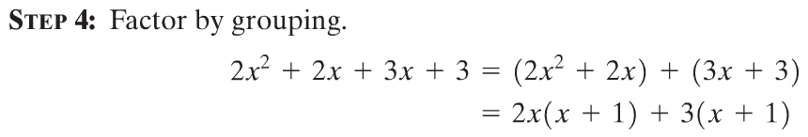


Slide 23

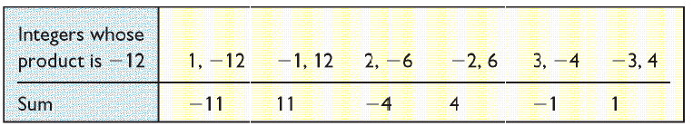
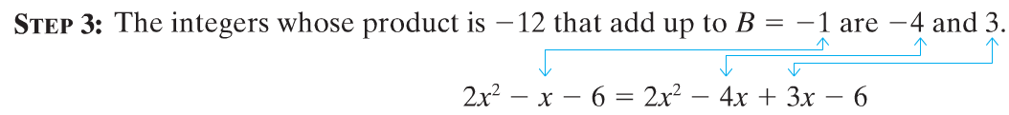




Slide 24
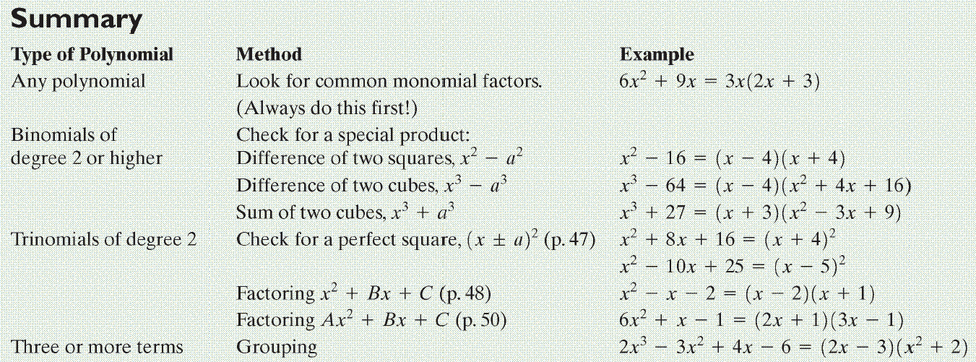
Copyright © 2012 Pearson Education, Inc. Publishing as Prentice Hall.

Slide 25

Copyright © 2012 Pearson Education, Inc. Publishing as Prentice Hall.

Slide 26
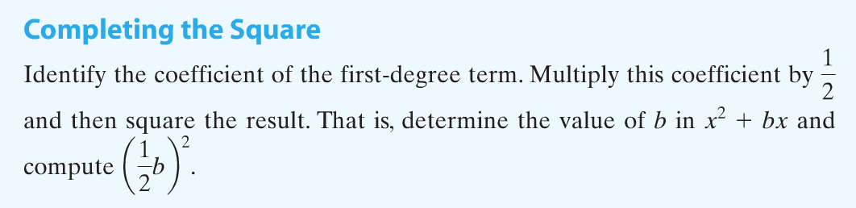
Copyright © 2012 Pearson Education, Inc. Publishing as Prentice Hall.

Slide 27

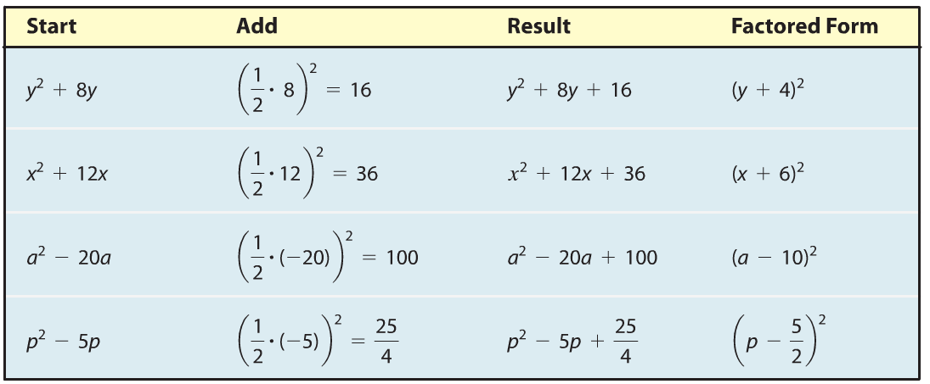
Copyright © 2012 Pearson Education, Inc. Publishing as Prentice Hall.

Slide 28
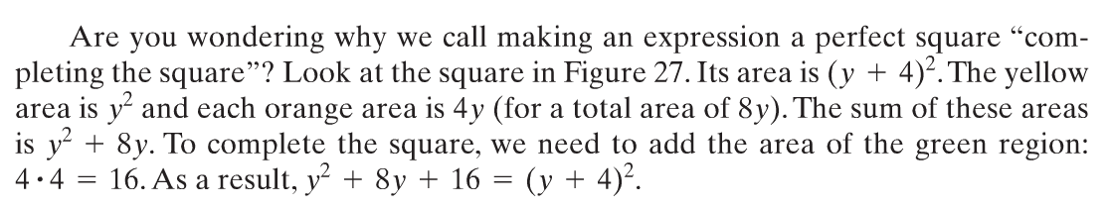
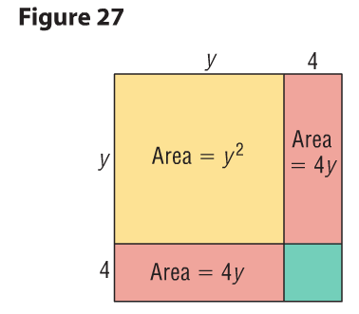
Copyright © 2012 Pearson Education, Inc. Publishing as Prentice Hall.

